Slide 1

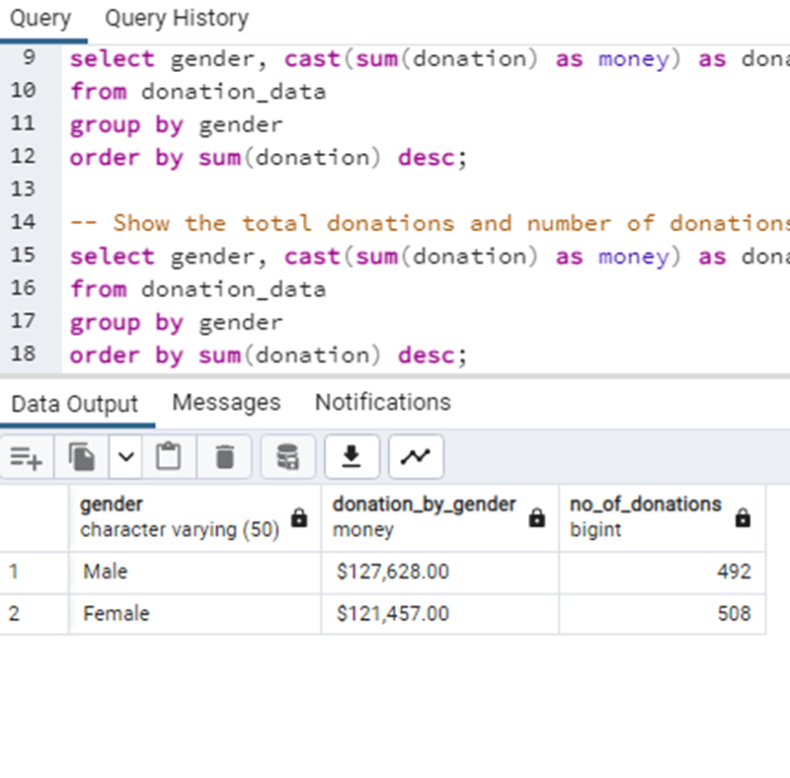
RECOMMENDATIONS
Suggestions to increase the number of donors;
From this data, we can deduce two things
Males donated more money than the females, this could be as a result of their earning capacity
Female donors are more than the males, this could be as a result of interest towards the cause.
The fundraising team will find strategies to keep increasing the number of females. Strategies like focusing on female empowerment/education.

Slide 2
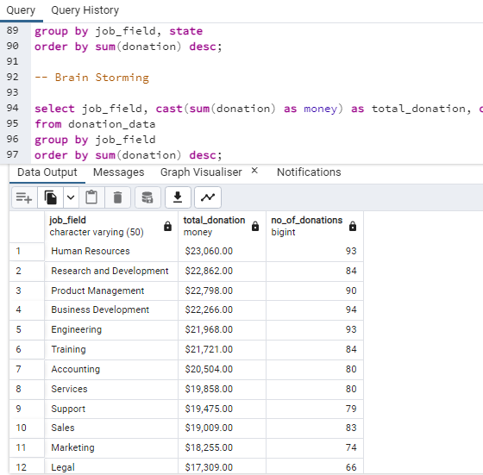
RECOMMENDATIONS
Suggestions to increase the value of donations;
There are 12 fields that donate to this charity organization and from this data, we can see top fields that are invested in Education For All and we are also focusing on earning capacity. The fundraising team could harness this and use this data to focus on these top fields. Strategies could range from organizing conferences and inviting people in theses fields to putting out a mini course highlighting top skills in these fields.

Slide 3
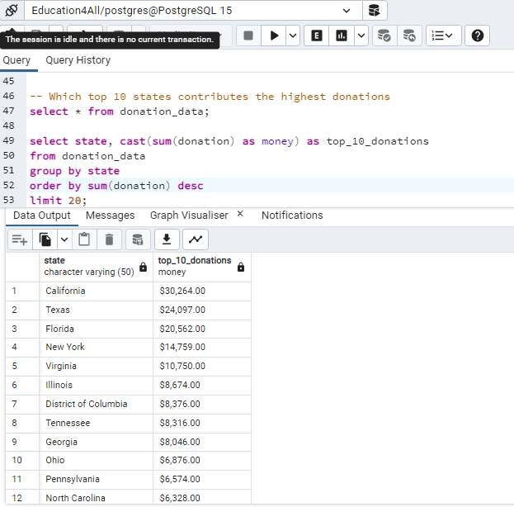
RECOMMENDATIONS
Additionally, giving a gift item (e.g. shirts)which has a blend of function and good publicity, a gift that is not only branded with the organization’s logo but also relevant with the donor’s interests thereby increasing the number of donors and value of donations.
Also, from the data, we could see the top 20 states with the highest donations. Strategies like doing surveys in cities in these states to know why large donations come from places like; California, Texas and Florida. You want to keep them coming and the only way to do this is to be able to answer the question - why?

Slide 4
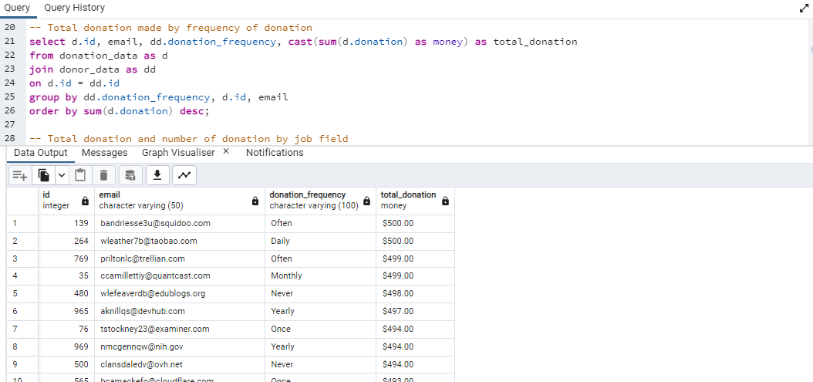
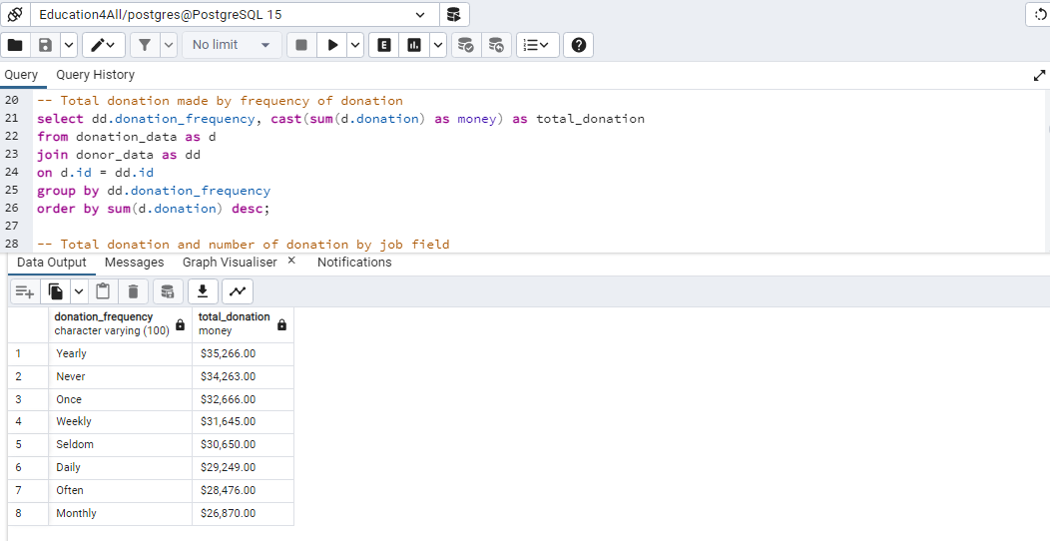
RECOMMENDATIONS
Suggestions to increase the donation frequency of the donors;
The data below shows donation frequency and the donor's details for easy reach. This data has been able to identify the consistent donors and the amount. Using this data, strategies like; Membership Programs, Donor Anniversary, Donor Spotlight on the organization’s website could help increase the frequency of the donations.

